Slide 1
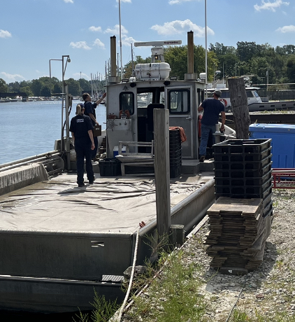
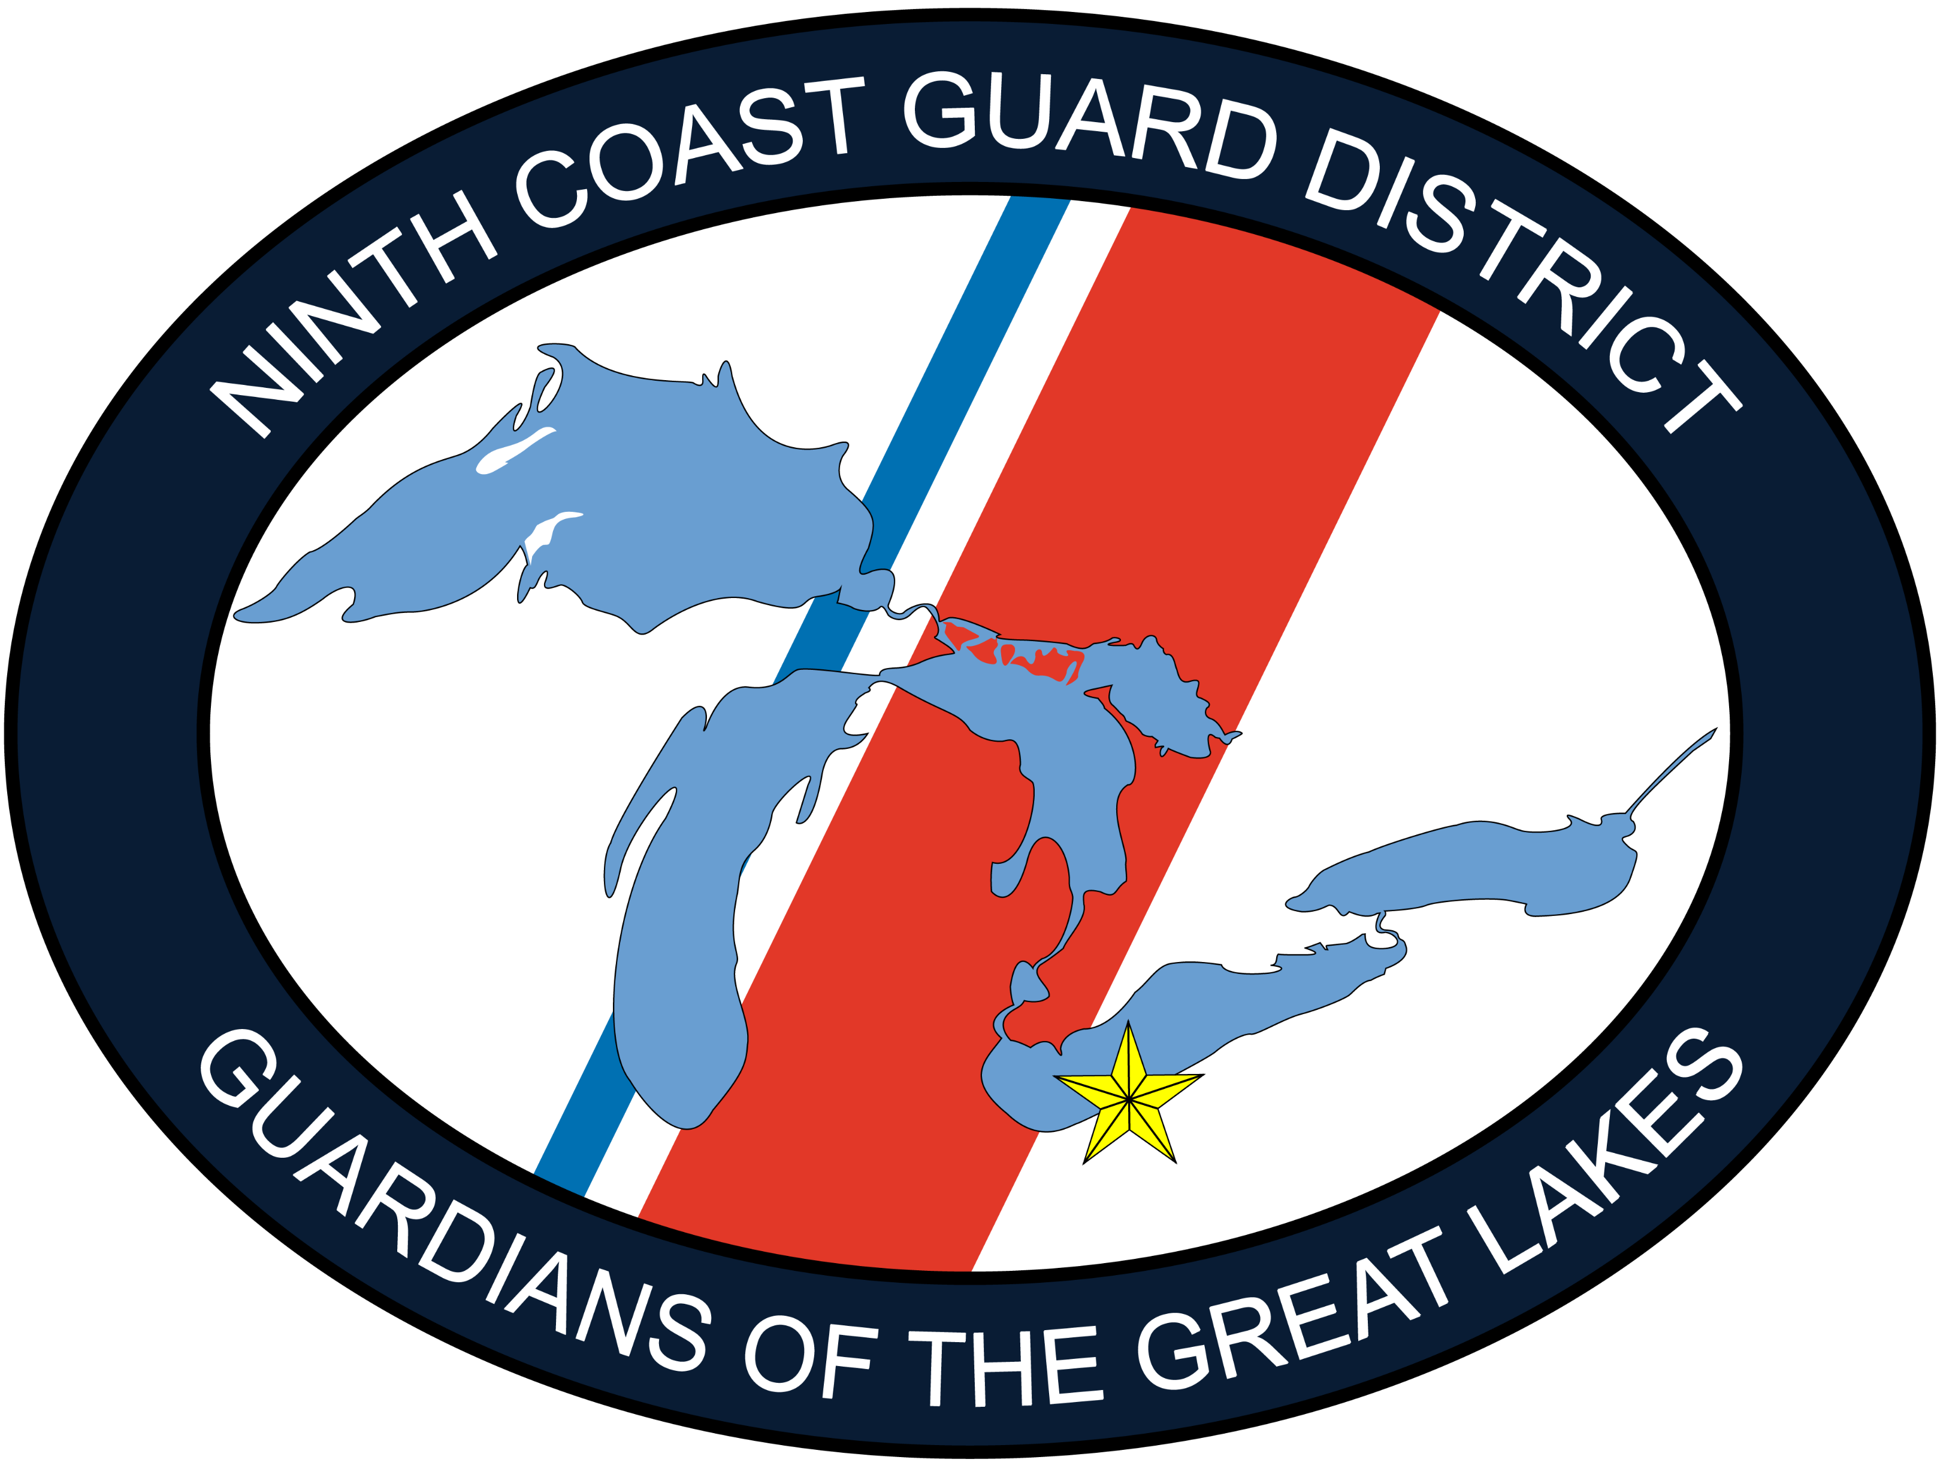
U.S.COAST GUARD
Ninth District
NSFSAC Meeting
For Jacksonville, FLA
April 2024
CDR Nicole Auth
Ninth Coast Guard District
Inspections & Investigations

Slide 2
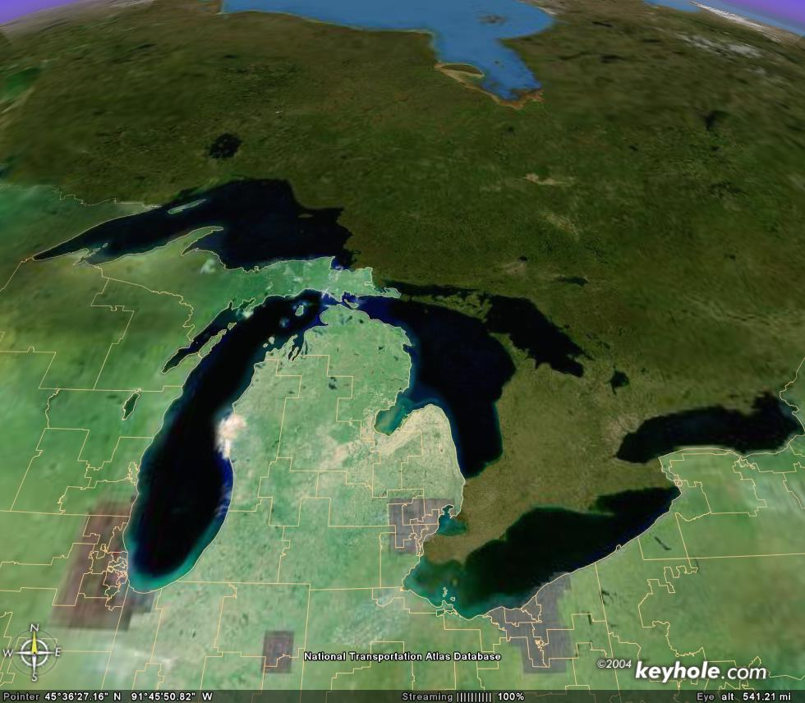
Ninth Coast Guard District
RESPONSIBILITY
8 U. S. states
5.4 million boaters
6,700 miles of shoreline
1,500 miles of international border
78 units
Sector Northern (Sault Ste. Marie)
PEOPLE
1,967 Active duty
97 Civilian
556 Reserve
3,900 Auxiliary
Sector Lake Michigan
Sector Eastern (Buffalo)
Sector Detroit
Ninth District Offices
Notes:
The Coast Guard men and women of the Ninth District are dedicated to year-round service to the people of the Great Lakes. Our regional headquarters is here in Cleveland, and we oversee four sectors that span the U. S. Great Lakes. Our sector offices are located in the great midwestern cities of Buffalo, Detroit, Milwaukee and Sault Ste. Marie. Together we supervise the activities of 46 multi-mission stations, 9 cutters, 2 air stations, 2 air facilities, 4 marine safety units, 2 marine safety detachments and a variety of other units. Our strength is truly our people, including active duty, Reserve, civilian and Auxiliary, who live by our core values of honor, respect and devotion to duty. Under the leadership of the district commander, Rear Admiral Peter Neffenger., we embrace his watch words of service, leadership and opportunity.
RESOURCES:
10 HH-65C helicopters
187 boats (15 MLBs, 15 UTBs, 15 UTMs, 36 RB-S, 32 UTL, 7 SPC, 5 BUSL, 10 TANB, 29 SKI, 25 cutter)
9 cutters

Slide 3
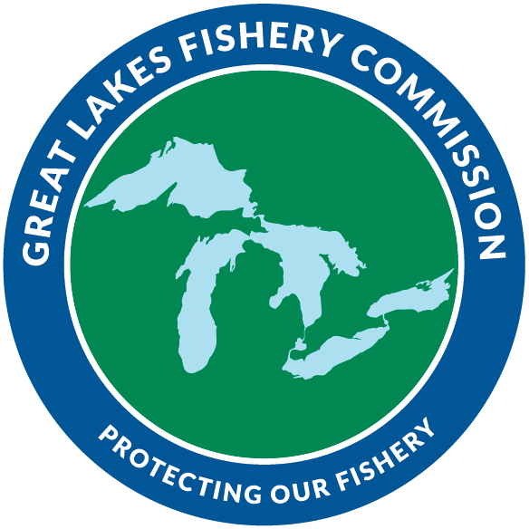
Great Lakes Cooperation
Established in 1955 by the CAN/U.S. Convention on Great Lakes Fisheries. The commission coordinates fisheries research, controls the invasive sea lamprey, and facilitates cooperative fishery mgmt.
Notes:
The Great Lakes fishery is worth more than $7 billion annually and cooperative fishery management sustains that economically and socially important element of Great Lakes ecosystems. Fisheries of the Great Lakes are managed by provincial, state, and tribal agencies, with support from the Canadian and U. S. federal governments.

Slide 4
Great Lakes Commercial Fishing Fleet
2024
Notes:
While there are currently 318 active commercial fishing licenses, there are a total of 469 commercial fishing vessels in the Great Lakes, 286 of which are tribally owned. The overwhelming majority of our 469 fishing vessels, are in Sector Sault Ste Marie’s AOR (362).

Slide 5
Questions?
CDR Nicole Auth
D9 Inspections & Investigations Branch
Nicole.D.Auth@uscg.mil (216) 645-9481
Mr. Mark Bobal
D9 CFVS & Passenger Vessel Safety Specialist
Mark.D.Bobal@uscg.mil (216) 902-6052

